Slide 1


Hosting a Static Website on AWS S3
Discover the simple steps to host your static website on Amazon S3, the reliable and scalable cloud storage service from AWS.
AS
by Ayush Srivastava

Slide 2

Create an S3 Bucket
1
Choose a Bucket Name
2
Choose a Region
3
Set Permissions
Pick the AWS region closest to your target audience for lower latency.
Decide whether to make your bucket public or keep it private.
Select a unique and descriptive name for your S3 bucket.

Slide 3
Upload Your Website Files
Select Files
Drag and Drop
Set Object Permissions
Choose the HTML, CSS, JavaScript, and other assets that make up your static website.
Easily upload your files to the S3 bucket using the AWS Management Console.
Make your website files public so they can be accessed from the internet.

Slide 4
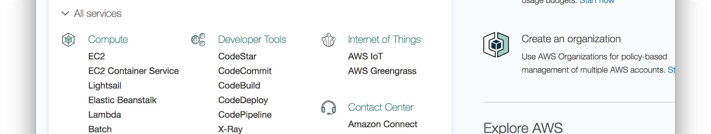
Enable Static Website Hosting
Configuration
Index Document
Endpoint URL
In the S3 console, enable the Static Website Hosting option for your bucket.
Specify the name of your main HTML file, usually "index.html".
Note the unique endpoint URL generated for your static website.

Slide 5
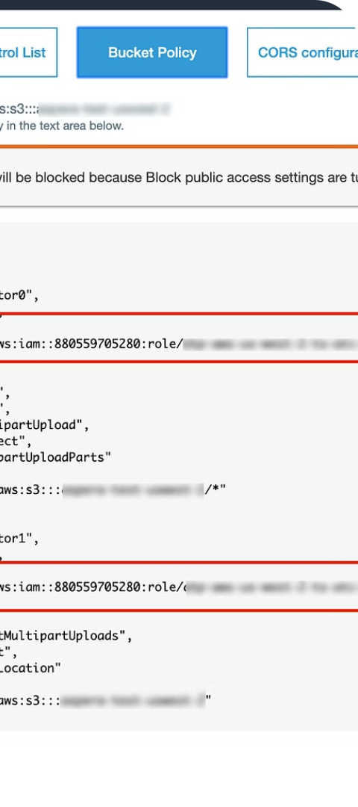
Make Your Website Public
1
Bucket Policy
2
Object ACLs
Create a bucket policy to grant public read access to your website files.
Ensure that the individual objects in your bucket have public read permissions.
3
Test the Endpoint
Visit the unique endpoint URL to verify that your website is accessible.

Slide 6
Distribute Your Website
Static Website URL
CloudFront CDN
Custom Domain
Share the endpoint URL with your users to allow them to access your website.
Consider using AWS CloudFront to deliver your static content with low latency and high availability.
Map a custom domain to your S3 bucket for a more professional website address.

Slide 7
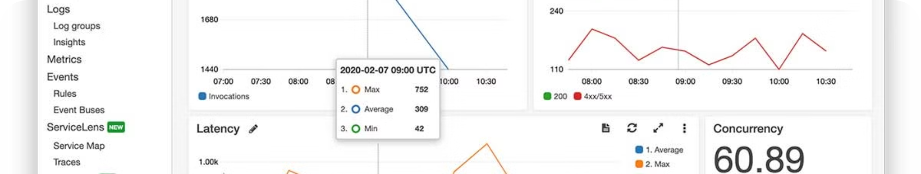



Monitor and Maintain
CloudWatch Monitoring
Automated Backups
Version Control
Use AWS CloudWatch to monitor the health and performance of your static website.
Regularly backup your website files to ensure data redundancy and easy restoration.
Implement a version control system to manage changes and deployments to your website.

Slide 8



Cost-Effective Hosting
Affordable
Scalable
Durable
S3 offers pay-as-you-go pricing, making it a cost-effective solution for hosting static websites.
S3 automatically scales to handle sudden spikes in traffic without the need for manual provisioning.
S3 provides 11 9s of durability, ensuring your website data is safe and secure.

Slide 9
Integrate with Other AWS Services
AWS Lambda
Leverage serverless functions for dynamic content or event-driven workflows.
Amazon CloudFront
Improve website performance and availability with a content delivery network.
Amazon Route 53
Use a custom domain name and manage your DNS settings for your website.

Slide 10




Get Started Today

